Slide 1
Data Acquisition

Slide 2
Data Acquisition
Get all data necessary for the analysis task at hand
Some data comes from inside the company
Need to go and talk with various data owners and get data
Difficult and time consuming
Some data comes from outside the company
Some companies have entire data acquisition team
Consider buying the data instead of trying to find it
Pulling data out of data sources (eg RDBMS) can be difficult from a technical viewpoint
Do not confuse this problem with the data extraction problem we talk about later

Slide 3
Data Lake
Before
Get only the data necessary for the current data analysis talk
Then do the DS pipeline over that data
Now
Get all data in the company that you can get your hand on
Dump all of it into a repository called data lake
Often store this over HDFS
Whoever wanting to do an analysis task will first go to the data lake
Privacy/security issues are important here

Slide 4
Types of Extraction
Notes:
#1 Good morning everyone, I am Chaitanya Gokhale from University of Wisconsin-Madison.
#2 I am here to talk about Corleone, a hands-off crowdsourced system for entity matching.
#3 This is joint work between UW-Madison and WalmartLabs.

Slide 5
Two Types of Extraction
Extracting from template-based data
An example on how this data is generated
Querying on Amazon by filling in a form interface using Jignesh Patel
The query goes to a database in the backend
Database result is plugged into template-based pages
This is called wrappers
Extracting entities and relationships from textual data

Slide 6
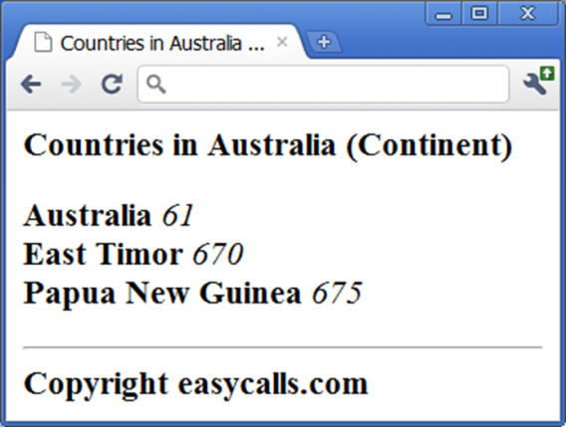
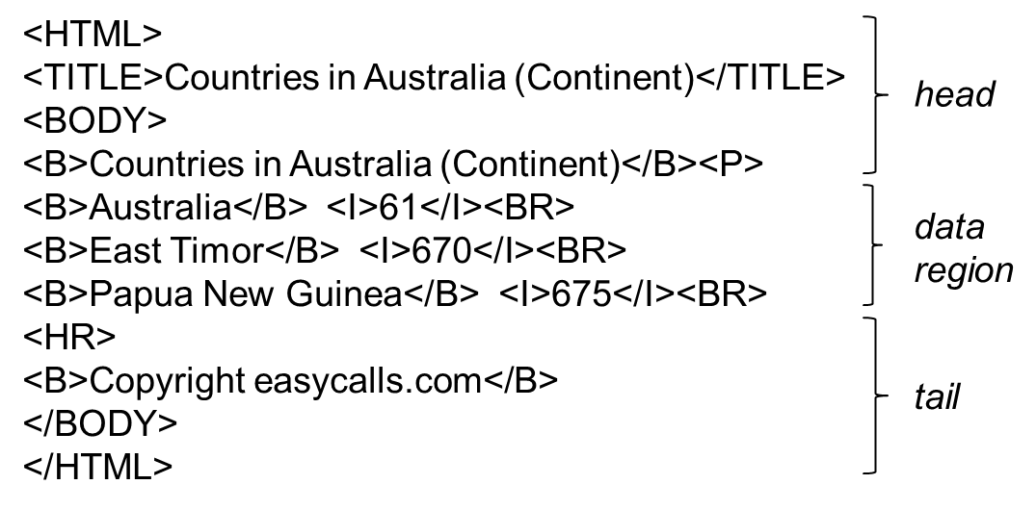
Wrappers

Slide 7
IE from Text
Attribute | Walmart Product | Vendor Product
Product Name | CHAMP Bluetooth Survival Solar Multi-Function Skybox with Emergency AM/FM NOAA Weather Radio (RCEP600WR) | CHAMP Bluetooth Survival Solar Multi-Function Skybox with Emergency AM/FM NOAA Weather Radio (RCEP600WR)
Product Short Description | BLTH SURVIVAL SKYBOX W WR
Product Long Description | BLTH SURVIVAL SKYBOX W WR | BLTH SURVIVAL SKYBOX W WR
Product Segment | Electronics | Electronics
Product Type | CB Radios & Scanners | Portable Radios
Color | Black
Actual Color | Black
UPC |  | 0004447611732
Unique product identifier (aka key in e-commerce industry)

Slide 8
IE from Text
Attribute | Walmart Product | Vendor Product
Product Name | GreatShield 6FT Apple MFi Licensed Lightning Sync Charge Cable for Apple iPhone 6 6 Plus 5S 5C 5 iPad 4 Air Mini - Black | GreatShield 6FT Apple MFi Licensed Lightning Sync Charge Cable for Apple iPhone 6 6 Plus 5S 5C 5 iPad 4 Air Mini - White
Product Short Description | GreatShield 6FT Apple MFi Licensed Lightning Sync Charge Cable for Apple iPhone 6 6 Plus 5S 5C 5 iPad 4 Air Mini - Black
Product Long Description | GreatShield Apple MFi Licensed Lightning Charge & Sync Cable This USB 2.0 cable connects your iPhone, iPad, or iPod with Lightning … | GreatShield Apple MFi Licensed Lightning Charge & Sync Cable This USB 2.0 cable connects your iPhone, iPad, or iPod with Lightning …
Product Segment | Electronics | Electronics
Product Type | Cable Connectors | Cable Connectors
Brand | GreatShield | GreatShield
Manufacturer Part Number | GS09055

Slide 9
IE from Text
For years, Microsoft Corporation CEO Bill Gates was against open source. But today he appears to have changed his mind. "We can be open source. We love the concept of shared source," said Bill Veghte, a Microsoft VP. "That's a super-important shift for us in terms of code access.“
Richard Stallman, founder of the Free Software Foundation, countered saying…
Select Name
From PEOPLE
Where Organization = ‘Microsoft’
PEOPLE
Name Title Organization
Bill Gates CEO Microsoft
Bill Veghte VP Microsoft
Richard Stallman Founder Free Soft..
Bill Gates
Bill Veghte
(from Cohen’s IE tutorial, 2003)

